Slide 1
VIF ISPIF Review
Zheng xie

Slide 2
CONTENT
Application&Request
Arch&Timing
Opt

Slide 3
Application Scenario && Request
Application Scenario
Up to 11 views of source video;
HDMI ( X1 )
DVP ( X2 )
MIPI ( X8 )
Data to ISP from DDR or Line_buffer;
Data to Codec from DDR;
Function
Balance bandwidth of source and destination;
Reconstruct video timing;
Eliminate abnormal output of Sensor;
Low Latency

Slide 4
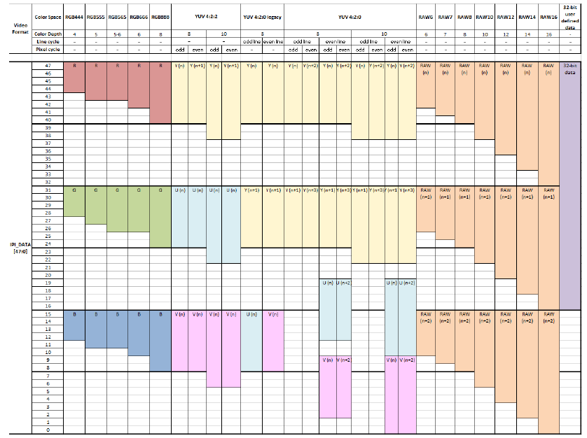
MIPI_DATA_TYPE

Slide 5
Arch: Top diagram

Slide 6
Arch: ISPIF

Slide 7
Single Sensor mode

Slide 8
SBS mode

Slide 9
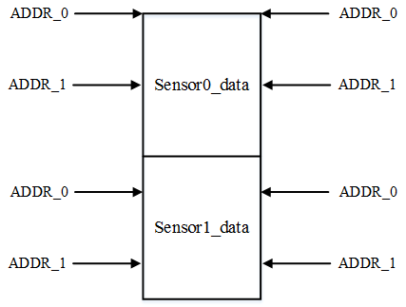
RD/WR Addr Ctrl
Eliminate abnormal output of Sensor!

Slide 10
Opt
Htotal Detect;
First_line →64 line Average
Ram size;
1536x144 → 1024x144

